Slide 1
Resume based job role PREDICTOR
INTERNAL GUIDE
Rayudu Soumya
Battula Ganesh
23P31F0084

Slide 2
index
ABSTRACT
EXISTING SYSTEM
DISADVANTAGES
PROPOSED SYSTEM
ADVANTAGES
SYSTEM ARCHITECTURE
ALGORITHMS
FUNCTIONAL REQUIREMENTS
NON-FUNCTIONAL REQUIREMENTS
MINIMUM SOFTWARE REQUIREMENTS
MINIMUM HARDWARE REQUIREMENTS
SCREENSHOTS
CONCLUSION

Slide 3
ABSTRACT
This project aims to assist job seekers by analyzing their resumes using Natural Language Processing (NLP) and Machine Learning (ML), and suggesting the most suitable job roles. By uploading a resume, the system extracts skills and other relevant details, and predicts job roles using a Random Forest classifier. This empowers candidates with personalized job role suggestions, improving their chances of applying to the right opportunities. System that analyzes a candidate’s resume and predicts the most suitable job roles . Random Forest classifier model, which has learned from a labeled dataset of resumes and corresponding job roles.

Slide 4
Existing system
In the existing job search system, candidates often rely on generic job portals or manual searches to find roles, which can be time-consuming, inefficient, and overwhelming. These platforms typically use basic keyword matching or applicant tracking systems (ATS) that do not fully understand the context of a candidate's resume. As a result, candidates receive irrelevant job recommendations or are unaware of the roles best suited to their skills and experience. The lack of personalization in current systems often leads to frustration and low success rates in job applications.

Slide 5
drawbacks
Limited Context Understanding – Struggles to interpret nuances like career transitions, soft skills, or domain shifts.
Lack of Real-time Skills Assessment – Doesn't evaluate current competency levels, only past experience.
Inability to Assess Potential – Fails to recognize transferable skills or career growth potential.
Difficulty Handling Unstructured Data – Struggles with varied resume formats, inconsistent terminology, and missing data.

Slide 6
Proposed system
To address these challenges, the proposed system introduces an intelligent, candidate-focused approach using Machine Learning (ML) and Natural Language Processing (NLP). In this system, candidates simply upload their resumes, and the application automatically extracts important features such as skills, qualifications, and work experience using NLP techniques. These features are then used to predict the most suitable job roles for the candidate. By analyzing real resume-job role datasets, the model learns patterns that help map resumes to appropriate job categories. The goal is to provide personalized, accurate job role suggestions that align with the candidate’s profile, ultimately simplifying and enhancing the job search process.

Slide 7
advantages
Automated Role Matching – Reduces manual effort in screening resumes by quickly identifying suitable job roles.
Scalability – Can handle large volumes of resumes efficiently compared to human recruiters.
Personalized Role Suggestions – Can recommend job roles based on skills, experience, and career trajectory.
Adaptability to Various Industries – Can be fine-tuned to work across different sectors and job roles.

Slide 8
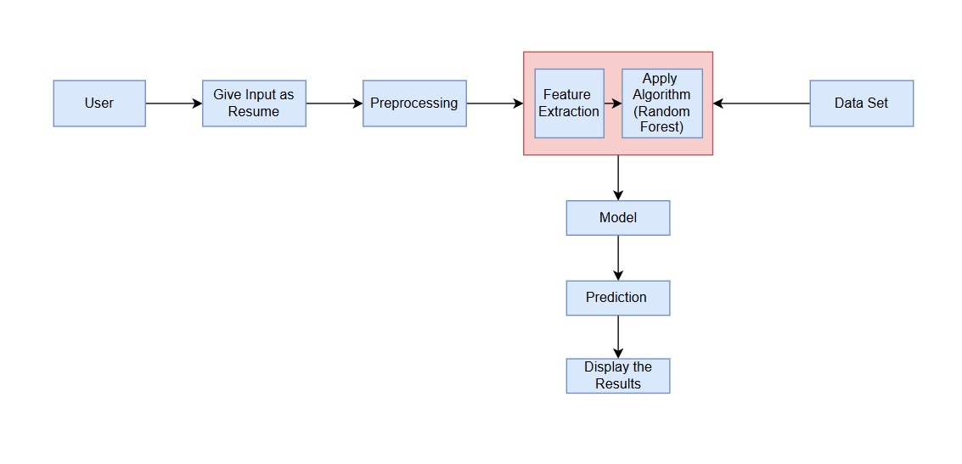
System architecture

Slide 9
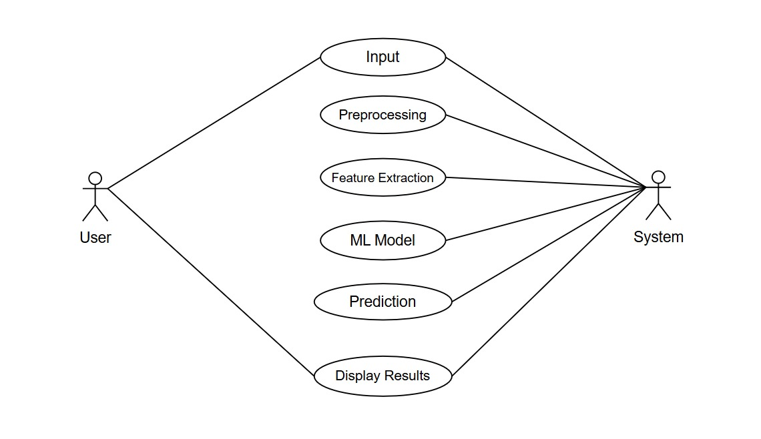
Use case diagram for system

Slide 10
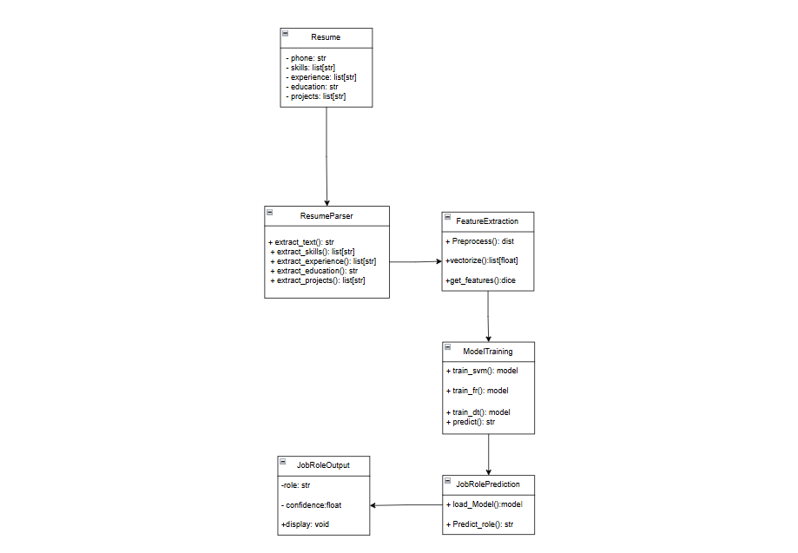
Class diagram for system

Slide 11
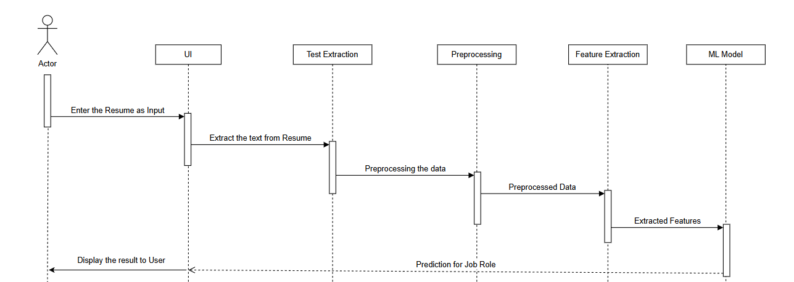
Sequence diagram for system

Slide 12
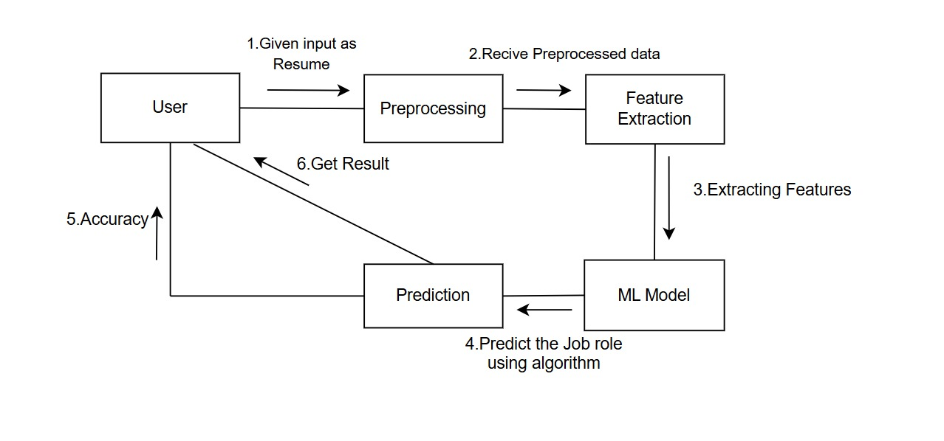
coollaboration diagram for system

Slide 13
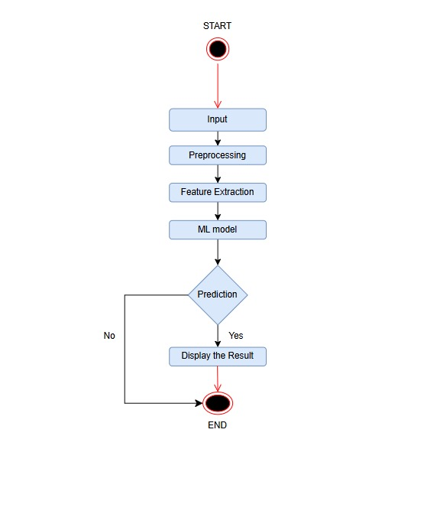
Activity diagram for system

Slide 14
ALGORITHM
The core algorithm used in this project is the Random Forest classifier, a powerful ensemble learning method that builds multiple decision trees and combines their results to improve accuracy and reduce overfitting. Random Forest is well-suited for this problem due to its ability to handle high-dimensional, unstructured data like resumes. It takes the extracted resume features as input and predicts the most relevant job roles based on patterns it has learned from the training data. Its robustness, speed, and interpretability make it an ideal choice for building a reliable job role prediction model.

Slide 15
Functional requirements
Resume Parsing – Extract structured information (skills, experience, education, etc.) from resumes.
Role Classification – Predict suitable job roles based on extracted data using machine learning models.
Keyword & Skill Matching – Identify relevant skills and match them to job role requirements.
Machine Learning Model – Train and deploy models for accurate role prediction and continuous improvement.
User Input Handling – Allow users to upload resumes in multiple formats (PDF, DOCX, etc.).
Personalized Job Suggestions – Provide recommendations based on career trajectory and aspirations.

Slide 16
Non-functional requirements
Scalability – Should efficiently handle a large volume of resumes without performance degradation.
Performance – Predictions should be generated within a few seconds to ensure a smooth user experience.
Accuracy – Machine learning models should achieve a high precision and recall in role prediction.
Usability – User-friendly interface for candidates and recruiters, with intuitive navigation.
Reliability – System should provide consistent and dependable results without frequent failures.

Slide 17
MINIMUM SOFTWARE REQUIREMENTS:-
Operating System : Windows 11
Technologies : Python 3.10,FLASK
Tools : Visual Studio
MINIMUM HARDWARE REQUIREMENTS :-
Processor : intel core i5
RAM : 8GB
Hard Disk : 512 GB
Speed : 3.14 GHZ

Slide 18
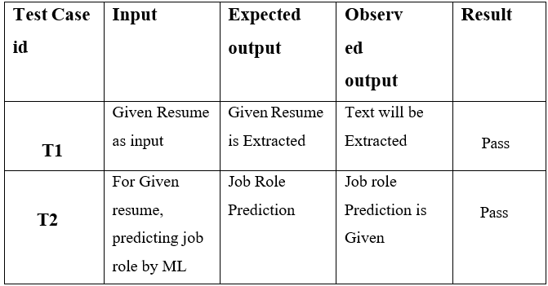
Sample Test Cases Specification

Slide 19
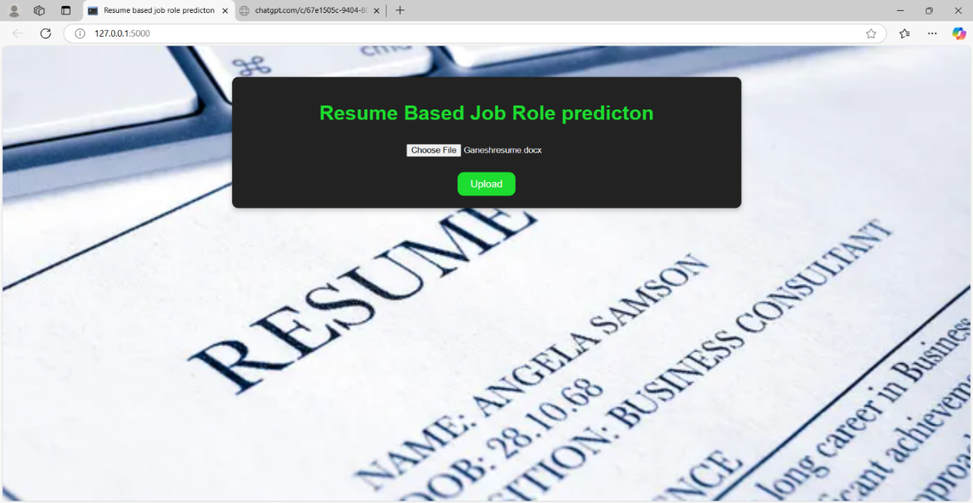

Slide 20
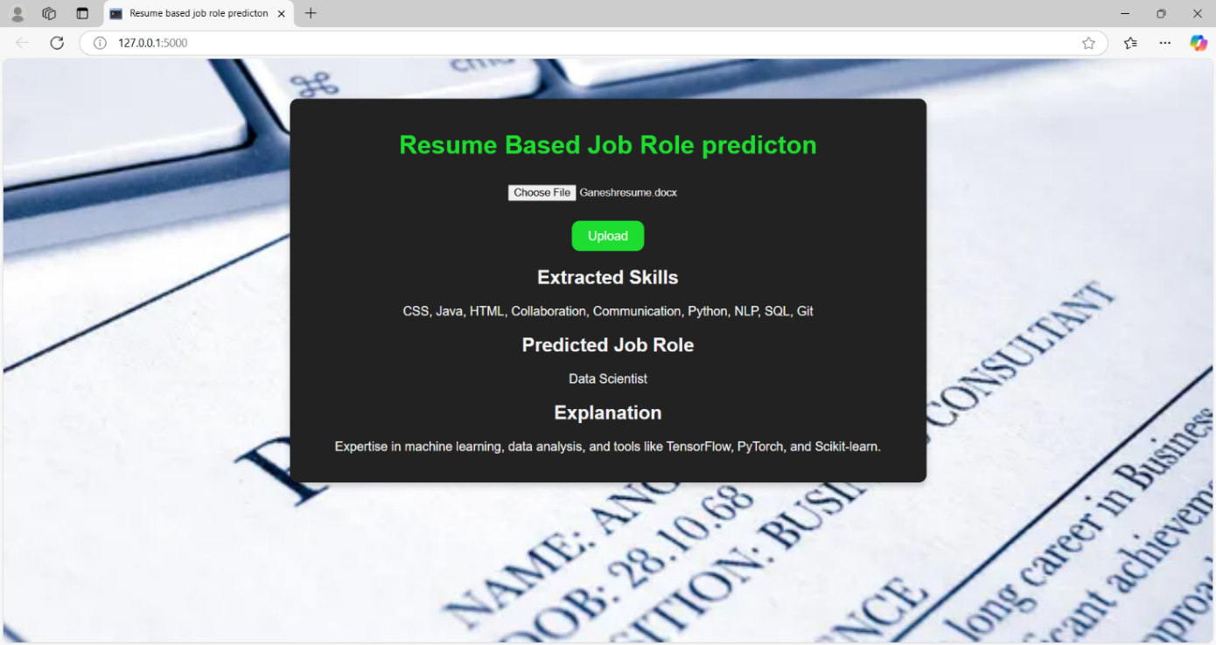

Slide 21
conclusion
The resume-based job role prediction system leverages machine learning to automate and enhance the recruitment process by efficiently analyzing resumes and accurately predicting suitable job roles .This system reduces manual effort, improves hiring efficiency. By integrating advanced parsing techniques, skill matching, and predictive analytics, it ensures personalized job recommendations while minimizing biases and improving fairness. Additionally, with scalability, security, and seamless integration into existing HR systems, this solution is adaptable to various industries. As technology evolves, continuous learning and improvements in accuracy will make the system even more effective, contributing to a more efficient and intelligent hiring process.

Slide 22
THANK YOU

